Slide 1
Properties of DNA Polymerases
Lecture - 11
Adds nucleotides in 5’ to 3’ direction
Requires a template and a primer
Extremely accurate
Also has proof-reading activity to correct errors
Very fast reaction due to processive nature

Slide 2
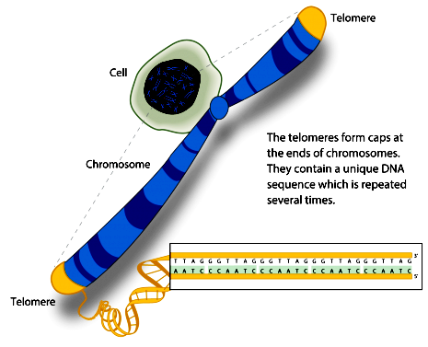
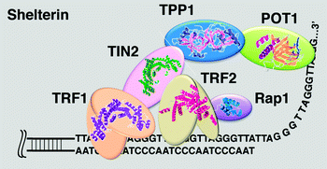
Replication at chromosome ends
In humans the telomere sequence is TTAGGG. This sequence is usually repeated several thousand times
Telomeric proteins protects the chromosomal ends from damage

Slide 3
End replication problem

Slide 4
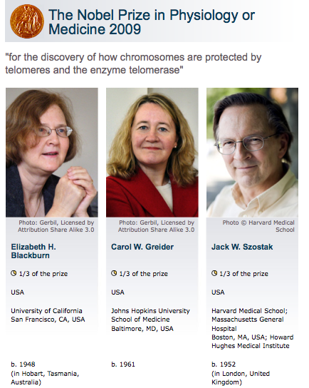

Slide 5
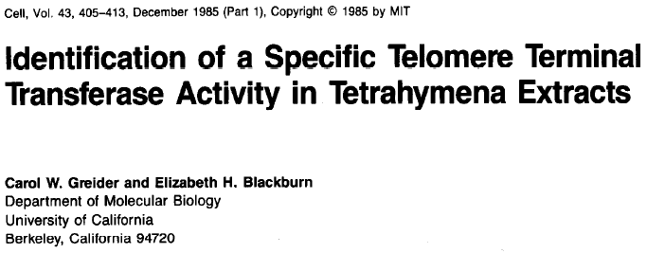
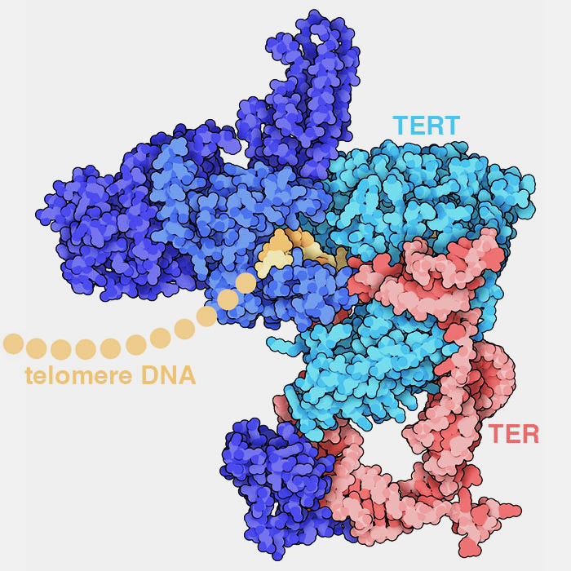
Telomerase: A ribonucleoprotein
TERT: Telomerase reverse transcriptase
TER: Telomerase RNA

Slide 6
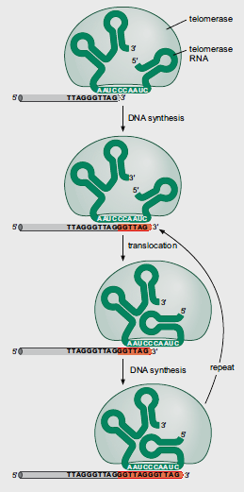
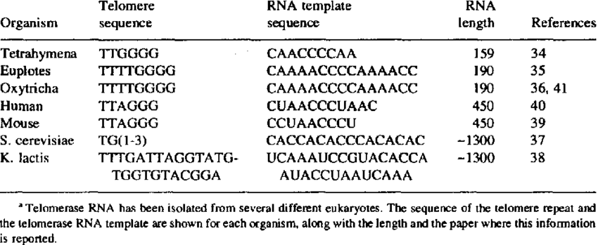
Annu Rev. Biochem. 1996
Telomerase: A RNA dependent DNA polymerase

Slide 7
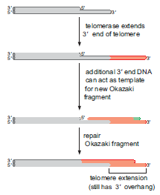
Extension of the 5’ end of the chromosome

Slide 8
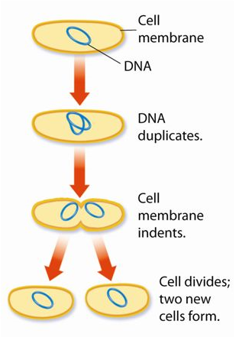
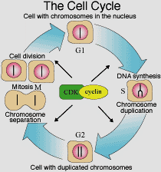
Regulation of replication
Bacteria
Eukaryotes

Slide 9
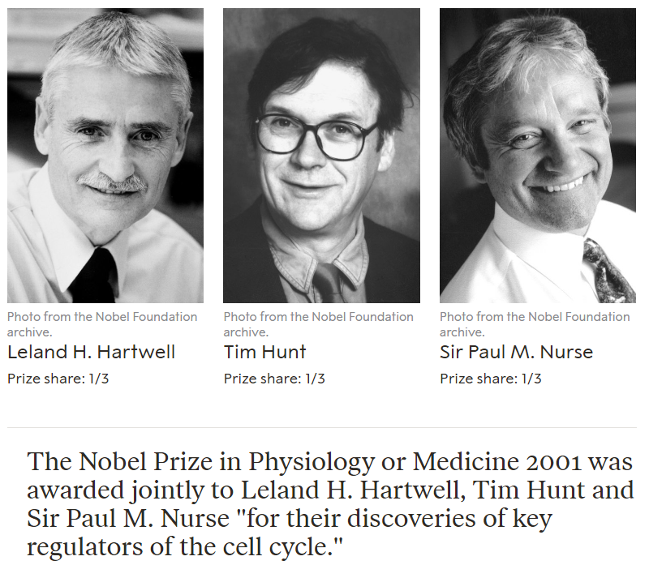

Slide 10
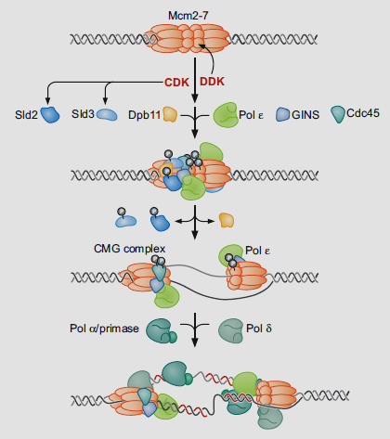
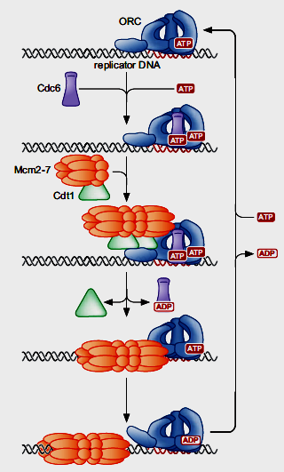
Helicase loading and activation
Notes:
cyclin-dependent kinase (CDK) and Dbf4-dependent kinase

Slide 11
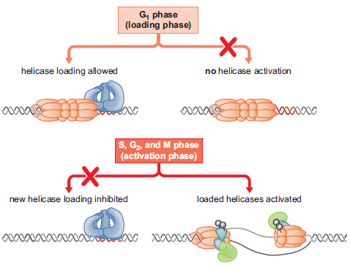
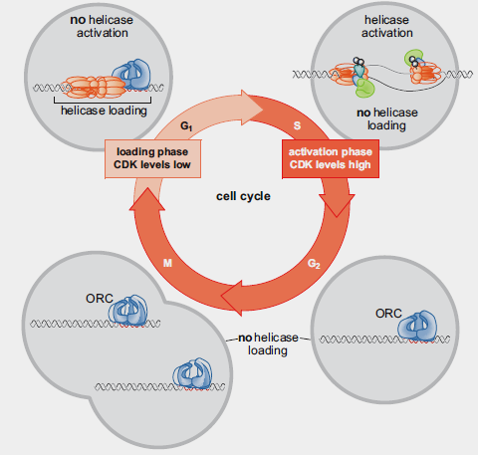
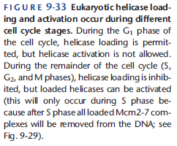
Fundamentals of Cell Cycle Regulation
Regulated helicase loading and activation

